Slide 1

WORKSHOP
history
Introduction to Data Analysis and Machine Learning
Term
services
teams
timeline
Term
Muhammad Usama Arain

Slide 2
What is Data Analysis
Data Analysis is a process of collecting, transforming, cleaning, and modeling data with the goal of discovering the required information. The results so obtained are communicated, suggesting conclusions, and supporting decision-making.
Term
teams
history
services
timeline
Term

Slide 3
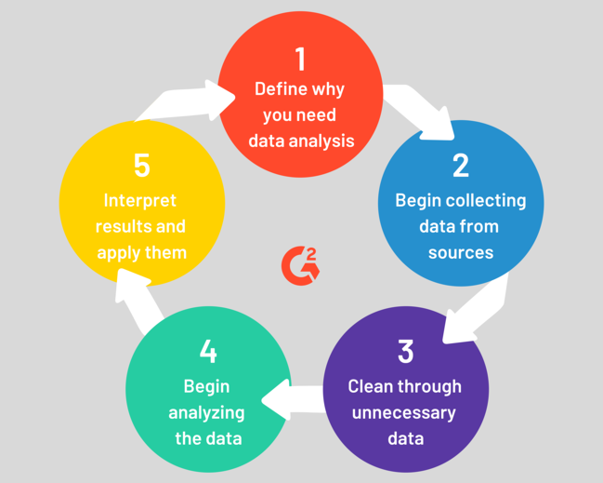
Term
teams
history
services
timeline
Term

Slide 4

Statistics
Statistics is the discipline that concerns the collection, organization, analysis, interpretation and presentation of data. In applying statistics to a scientific, industrial, or social problem,
Term
teams
history
services
timeline
Term

Slide 5
Statistics Types
1) Descriptive Statistics
2) Inferential Statistics
Descriptive statistics are brief description that summarize a given data set, which can be either a representation of the entire or a sample of a population. [ Measure of Center and Variability ]
Statistical inference is the process of using data analysis to deduce properties of an underlying probability distribution.for example by testing hypotheses and deriving estimates.
Term
teams
history
services
timeline
Term

Slide 6

Experiment Study
Observational
Study
Term
services
teams
timeline
Term
WHICH ONE TO CHOOSE
WHICH ONE TO CHOOSE
Show Causation
Show Relationship

Slide 7
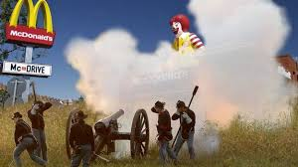
Golden Arches theory of conflict prevention
“No two countries with McDonald’s in them will ever go to war”
Guys what do you think Does this theory holds TRUE ?
Term
teams
history
services
timeline
Term

Slide 8
Countries are well integrated into the global economy. If they are well integrated into global economy, then their respective economies would suffer greatly in a war
So the theory goes that those two countries simply wouldn't want to fight a war, because they would both lose.
Trade > Surplus > Better Life
Example Dubai and India over Kashmir issue
India and America over Kashmir issue
Term
teams
history
services
timeline
Term

Slide 9
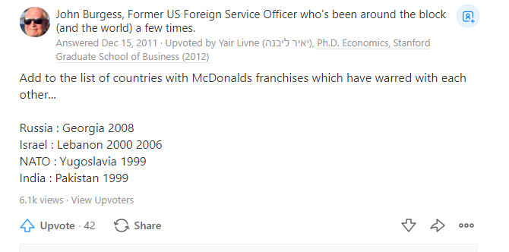
Term
teams
history
services
timeline
Term
Confusion ?

Slide 10
Coorelation does not mean Causation !
Term
teams
history
services
timeline
Term

Slide 11
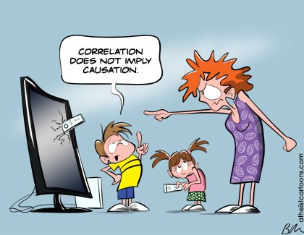
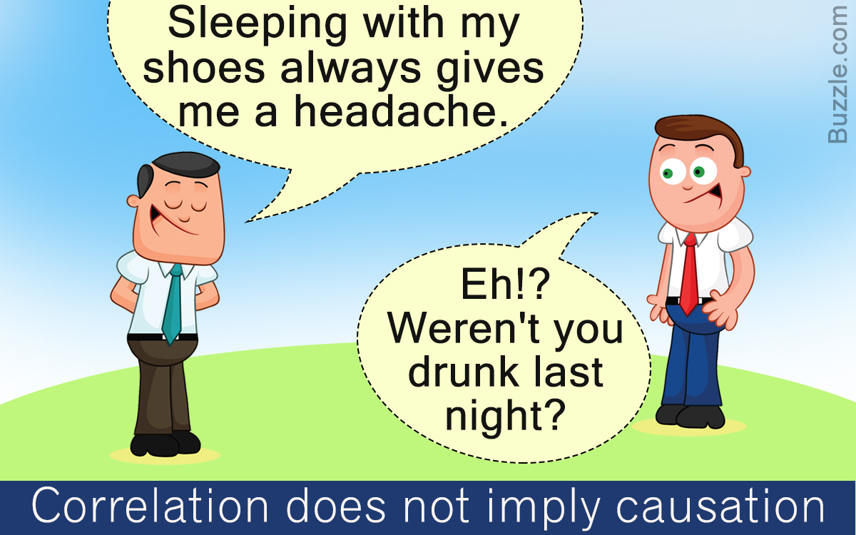
Coorelation > Less info: Can't see undercovers
Causation > More info : Transparent things
Term
teams
history
services
timeline
Term

Slide 12
Why Graphs are Important
Match Report | Scores
1st Over | 6
2nd Over | 8
3rd Over | 15
4th Over | 19
5th Over | 25
Survey
teams
Survey
services
timeline
Term

Slide 13
Why Graphs are Important...
Overs | Score A | Score B
1st | 6 | 4
2nd | 8 | 10
3rd | 15 | 12
4th | 19 | 17
5th | 25 | 20
Survey
teams
Survey
Term
services
timeline
Overs | Scores
1st | 6
2nd | 2
3rd | 7
4th | 4
5th | 6

Slide 14
Let's Conduct Survey....
Survey
teams
Survey
Survey
services
timeline
https://github.com/usamahabib123/Data-Analysis-Workshop

Slide 15


follow
Survey
services
teams
timeline
about
2014
2015
2016
HEADING
HEADING
HEADING
YOU CAN ADD SOME BRIEF TEXT HERE
YOU CAN ADD SOME BRIEF TEXT HERE
YOU CAN ADD SOME BRIEF TEXT HERE

Slide 16



01
02
03
follow
history
services
teams
timeline
about
ALAN MARTIN
JHON DOE
PABLO PICASO
CEO, COMPANY NAME
CEO, COMPANY NAME
CEO, COMPANY NAME
Here Write Brief Message About Yourself
Here Write Brief Message About Yourself
Here Write Brief Message About Yourself

Slide 17






Web Design
Web Design
Here you need to add some brief about the service that your company is providing currently
Here you need to add some brief about the service that your company is providing currently
Web Design
Web Design
history
follow
services
teams
Here you need to add some brief about the service that your company is providing currently
Here you need to add some brief about the service that your company is providing currently
timeline
about
Web Design
Web Design
Here you need to add some brief about the service that your company is providing currently
Here you need to add some brief about the service that your company is providing currently

Slide 18



follow
history
services
teams
timeline
about
8M
6M
7M
Add Some Brief Text Here to Explain
Add Some Brief Text Here to Explain
Add Some Brief Text Here to Explain

